Slide 1
20XD24 - OBJECT ORIENTED PROGRAMMING
Chapter – IV
Operator Overloading

Slide 2
Outline
Introduction
Overloading Unary and Binary Operators
Overloading Binary Operators using Friend functions
Operator Type conversion

Slide 3
Introduction
C++ provides many operators to manipulate data of the primitive data types
However, what if you wish to use an operator to manipulate class objects?
Operator Overloading - C++ allows you to redefine standard operators work when used with class objects
  Using traditional operators with user-defined objects
  A way of achieving static polymorphism is Operator overloading
Example
    Operator << is both the stream-insertion operator and the bitwise left-shift operator

Slide 4
Overloaded Operator Rules
When creating new overloaded operators, programmers cannot
change the meaning of an intrinsic or built-in operator (e.g., you cannot change "+" to "-" ) – ie., The meaning of how an operator works with built-in types, such as int, remains the same
  the precedence or associativity of any operator
  the number of operands
  create a new operator (i.e., they can only overload existing operators)
  overload an operator outside of a class context

Slide 5
Operator overloading
Overloading an operator
  Write function definition as normal
  Function name is keyword operator followed by the symbol for the operator being overloaded
  Example : operator + used to overload the addition operator (+)
Two ways of overloading the operators
  Using Member function (a non-static member function)
  Using Friend function

Slide 6
Operator Overloading
Syntax (using member function)
Number of arguments in a member function for
    Unary operator – 0
    Binary operator – 1
Keyword
Operator to be overloaded
returnType classname :: Operator OperatorSymbol (argument list)
{
// Function body
}

Slide 7
Operator Overloading
Syntax (using friend function)
Number of arguments in a friend function for
    Unary operator – 1
    Binary operator – 2
Keyword
Operator to be overloaded
returntype operator OperatorSymbol (argument list)
{
// Function body
}

Slide 8
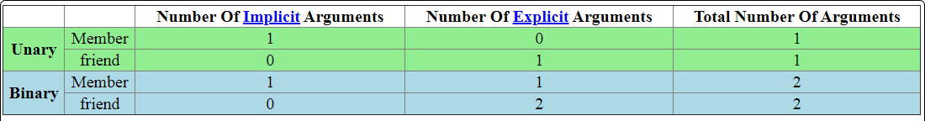
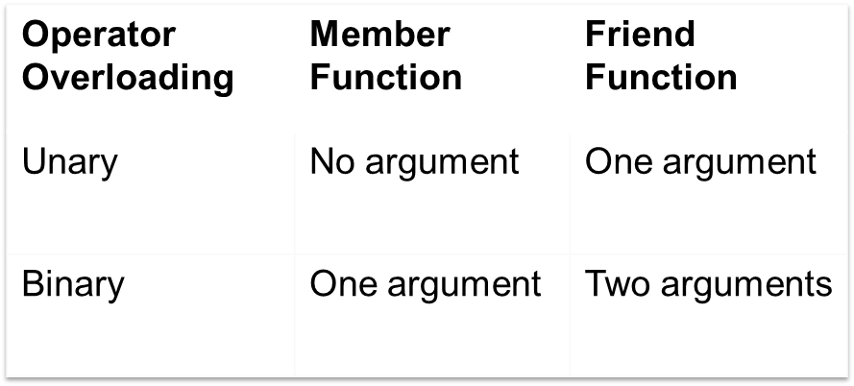
Operator Overloading
The relationship between operator operands and function arguments

Slide 9
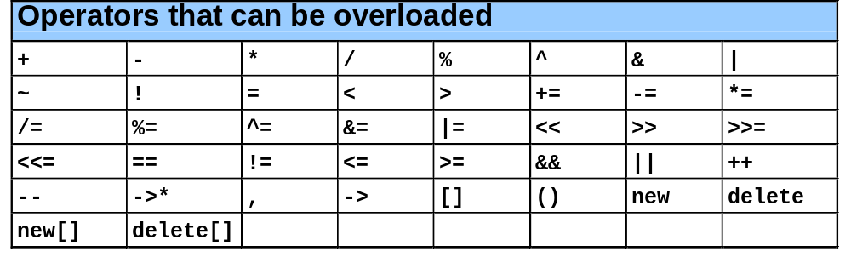
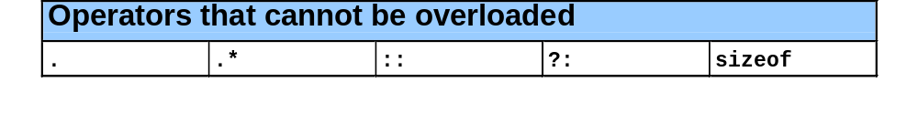
Operator Overloading

Slide 10
Operator Overloading
Operators that can be overloaded using member and friend functions
Note
  Overloading does not actually add any capabilities to C++. Everything you can do with an overloaded operator you can also do with a function.
  However, overloaded operators make your programs easier to write, read, and maintain.
 | Using member function | Using friend function
Operators | = ( ) [ ] -> | << >>

Slide 11
Operator Functions
Operator Functions as Class Members
Leftmost operand must be of same class as operator function.
Use this keyword to implicitly get left operand argument.
Operators (), [], -> or any assignment operator must be overloaded as a class member function.
Called when
  Left operand of binary operator is of this class
  Single operand of unary operator is of this class
Operator Functions as friend functions
Need parameters for both operands
Can have object of different class than operator

Slide 12
Binary Operator Overloading
Binary operator function as a member function
  class Time
  {
  int hrs, mins;
  public:
  Time (int h,int m)
  { hrs=h;mins=m; }
  void show()
  { cout<<hrs<<“:”<<mins; }
  void sum(Time t)
  { hrs+=t.hrs; mins+=t.mins;
  }
  Time operator + (Time t)
  { Time temp;
  temp.hrs=hrs+t.hrs;
  temp.mins=mins+t.mins;
  return temp;
  }
  };
int main()
{
Time t1(10,20), t2(11,30);
t1.show();
t2.show();
// t1.sum(t2);
t1=t1+ t2;
// t1.operator + (t2)
t1.show();
t2.show();
}
hrs 10: 20 mins
hrs 11: 30 mins
hrs 21: 50 mins
hrs 11: 30 mins

Slide 13
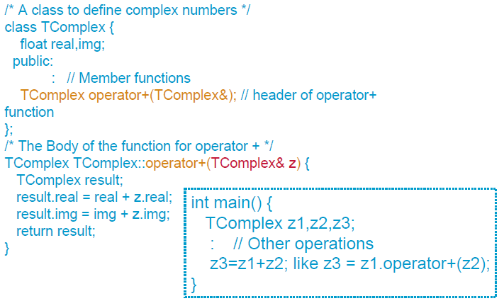
Overloading + Operators for Complex class

Slide 14
Binary Operator Overloading
Binary operator function as a friend function
class Time
{
int hrs, mins;
public:
Time (int h,int m)
{ hrs=h;mins=m;}
void show()
{ cout<<hrs<<“:”<<mins; }
friend Time operator + (Time, Time);
};
Time operator + (time t1,time t2)
{ Time temp;
temp.hrs=t1.hrs+t2.hrs;
temp.mins=t1mins+t2.mins;
return temp;
}
int main()
{
Time t1(10,20), t2(11,30);
t1.show();
t2.show();
t1=t1+ t2;
// operator + (t1, t2);
t1.show();
t2.show();
}
hrs 10: 20 mins
hrs 11: 30 mins
hrs 21: 50 mins
hrs 11: 30 mins

Slide 15
Overloading + Operator for Complex class
class Complex
{
int num1, num2;
public:
void accept()
{ cout<<"\n Enter Two Complex Numbers : ";
cin>>num1>>num2;
}
friend Complex operator+(Complex c1, Complex c2);
void display()
{ cout<<num1<<"+"<<num2<<"i"<<"\n"; }
};
Complex operator+(Complex c1, Complex c2)
{
Complex c;
c.num1=c1.num1+c2.num1;
c.num2=c1.num2+c2.num2;
return c;
}
int main()
{
Complex c1,c2, sum;
c1.accept();
c2.accept();
sum = c1+c2;
c1.display();
c2.display();
sum.display();
return 0;
}

Slide 16
Overloading > Operator
#include <iostream>
using namespace std;
class Distance {
private:
int feet;
int inches;
public:
Distance() {
feet = 0;
inches = 0;
}
Distance(int f, int i) {
feet = f;
inches = i;
}
void displayDistance() {
cout << "F: " << feet << " I:" << inches <<endl;
}
bool operator < (const Distance& d) {
if(feet < d.feet) {
return true; }
if(feet == d.feet && inches < d.inches) {
return true; }
return false;
}
};
int main() {
Distance D1(11, 10), D2(5, 11);
if( D1 < D2 ) // D1.operator < (D2)
{
cout << "D1 is less than D2 " << endl; }
else {
cout << "D2 is less than D1 " << endl; }
}

Slide 17
Unary Operator Overloading
The + and - are unary operators. They can be overloaded, too. Since the unary operator operates on one operand that is the calling object itself, the unary function operator has no parameters
#include<iostream>
using namespace std;
class NUM
{ private: int n;
public:
void getNum(int x)
{ n=x; }
void dispNum( )
{ cout << "value of n is: " << n; }
// Operator Function as Member Function
void operator - ()
{ n=-n; }
};
int main()
{
NUM num;
num.getNum(10);
-num; //num.operator-()
num.dispNum();
cout << endl;
}
value of n is: -10

Slide 18
Unary Operator Overloading
Unary Minus Overloading using Friend Function
#include<iostream>
using namespace std;
class NUM
{ private: int n;
public:
void getNum(int x)
{ n=x; }
void dispNum( )
{ cout << "value of n is: " << n; }
friend void operator - (NUM n1) ;
};
void operator - (NUM n1) ;
{ n1.n = - n1.n; }
int main()
{
NUM num;
num.getNum(10);
-num; //operator-(num)
num.dispNum();
cout << endl;
}
value of n is: -10

Slide 19
Unary Operator Overloading
Unary operator function as a member function
  class Point
  { int x, y;
  public:
  Point() {x = y = 0; }
  Point & operator++()
  {
  x++;
  y++;
  return *this;
  }
  Point& operator--()
  { x--;
  y--;
  return *this;}
  };
int main()
{
Point p, p1,p2;
p1= p++; // p.operator++()
p2= --p; // p.operator -- ()
}

Slide 20
Unary Operator Overloading
Unary operator function as a friend function
class Point
{ int x, y;
public:
Point() {x = y = 0; }
Point & operator++()
{ x++;
y++;
return *this; }
friend point operator -- (point);
};
Point operator -- (point &p)
{ p.x--;
p.y--;
return p;
}
main()
{
Point p, p1,p2;
p1= p++;
p2= --p;
}

Slide 21
Unary Operator Overloading
There is no distinction between the prefix and postfix overloaded operator functions
The new syntax for postfix operator overloaded function is
  ret-type operatorop(int) // member function
  ret-type operatorop(arg, int) // friend function
friend Point& operator++( Point& ) // Prefix increment
friend Point& operator++( Point&, int ) // Postfix increment
friend Point& operator--( Point& ) // Prefix decrement
friend Point& operator--( Point&, int ) // Postfix decrement

Slide 22
Unary Operator Overloading
class Point
{
public:
// Declare prefix and postfix increment operators.
Point& operator++(); // Prefix increment operator.
Point operator++(int); // Postfix increment operator.
// Declare prefix and postfix decrement operators.
Point& operator--(); // Prefix decrement operator.
Point operator--(int); // Postfix decrement operator.
// Define default constructor.
Point() { x = y = 0; }
// Define accessor functions.
int x() { return x; }
int y() { return y; }
private:
int x, y;
};

Slide 23
Unary Operator Overloading
// Define prefix increment operator.
Point& Point::operator++()
{
x++;
y++;
return *this;
}
// Define postfix increment operator.
Point Point::operator++(int)
{
Point temp = *this;
++*this;
return temp;
}
// Define prefix decrement operator.
Point& Point::operator--()
{
x--;
y--;
return *this;
}
// Define postfix decrement operator.
Point Point::operator--(int)
{
Point temp = *this;
--*this;
return temp;
}
main()
{
Point p, p1,p2;
p1= p++;
// p.operator++(int)
p2= --p;
}

Slide 24
Friend operator Functions Add Flexibility
Overloading an operator by using a friend or a member function makes, no functional difference
In exceptional situation in which overloading by using a friend increases the flexibility of an overloaded operator
For example
    Object + 100 // object. Operator+(100)
    100 + object // In this case, it is integer that appears on the left
    //100.operator+(object) //invalid
    //operator + (object, 100)
    // operator + (100, object)

Slide 25
Friend Operator Functions Add Flexibility
class Point
{
public:
int x,y;
Point () {};
Point (int, int);
friend Point operator +(int, Point);
friend Point operator +(Point, int);
};
Point::Point (int a, int b)
{ x = a; y = b; }
Point operator+ (Point P, int i)
{ Point temp;
temp.x = P.x + i;
temp.y = P.y + i;
return (temp);
}
Point operator+ (int i, Point P)
{ Point temp;
temp.x = i + P.x;
temp.y = i + P.y;
return (temp);
}
main ()
{ Point a (3,1);
Point b (1,2);
Point c;
c = a + 5;
cout << c.x << "," << c.y;
c=10+a;
cout << c.x << "," << c.y;
}

Slide 26
Operator Functions as Class Members vs. as friend Functions
Member vs non-member
  Operator functions can be member or non-member functions
  When overloading ( ), [ ], -> or any of the assignment operators, a member function must be used
Operator functions as member functions
  Leftmost operand must be an object (or reference to an object) of the class
  If left operand of a different type, operator function must be a non-member function
Operator functions as non-member functions
  Must be friends if needs to access private or protected members
  Enable the operator to be commutative

Slide 27
Assignment Operator Overloading
Assignment operator (=) is, strictly speaking, a binary operator. Its declaration is identical to any other binary operator
No operator = can be declared as a non-member function
It is not inherited by derived classes
A default operator = function can be generated by the compiler for class types if none exists (bitwise shallow copy)
User defined operator= function performs member wise deep copy

Slide 28
Assignment Operator Overloading
class String
{
char* data;
public:
String(){ data=NULL; }
String(const char* s = "")
{ data = new char[20];
strcpy(data,s);
}
~String( )
{ delete [ ] data;
}
void assign(char *str)
{ strcpy(data,str);
}
void display()
{ cout << data;
}
};
main()
{
String s = "hello";
String t;
t=s;
s.display( );
t.display( );
t.assign(“world”);
s.display( );
t.display( );
}
Default assignment
hello
hello
world
world
data
s
hello\0
t
data
data
s
world\0
t
data

Slide 29
Assignment Operator Overloading
Overloaded operator function
void operator=(const String& s)
{
data = new char[strlen(s.data)+1];
strcpy(data, s.data);
}
data
hello\0
s
Deep copy
data
t
hello\0

Slide 30
Overloading I/O Stream Operators
Overloaded << and >> operators
  Overloaded to perform input/output for user-defined types
  Left operand of types ostream & and istream &
  Must be a non-member function because left operand is not an object of the class
  Must be a friend function to access private data member
  Example: cin>>C1; // cin.operator>>(C1) //incorrect // mem.fun
        cout<<C1; // operator<<(cout, C1); // correct // friend fun.
Syntax
Output stream
Keyword
Ostream object: cout
Keyword
Reference types
Ostream operator
User defined object
  friend ostream & operator << ( ostream &out, arg)
  { //display attributes
  return out;
  }

Slide 31
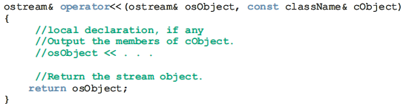
Overloading I/O Stream Operators
In this function definition
Both parameters are reference parameters
The first parameter—that is, osObject— is a reference to an ostream
object
The second parameter is usually a const reference to a particular class, because the most effective way to pass an object as a parameter to a class is by reference. The word const appears before the class name because we want to print only the member variables of the object. That is, the function should not modify the member variables of the object
The function return type is a reference to an ostream object

Slide 32
Overloading I/O Stream Operators
The return type of the function to overload the operator << must be a reference to an ostream object for the following reasons
  Suppose that the operator << is overloaded for the class rectangleType. The statement: cout << myRectangle;
  is equivalent to the statement: operator<<(cout, myRectangle);
  This is a perfectly legal statement because both of the actual parameters are objects, not the value of the objects. The first parameter, cout, is of type ostream; the second parameter, myRectangle, is of type rectangleType
Now consider the following statement:
cout << myRectangle << yourRectangle;
This statement is equivalent to the statement:
operator<<(operator<<(cout, myRectangle), yourRectangle);

Slide 33
Overloading I/O Stream Operators
because the associativity of the operator << is from left to right
To execute the previous statement, we must first execute the expression:
cout << myRectangle
that is, the expression: operator<<(cout, myRectangle)
After executing this expression, which outputs the value of myRectangle, whatever is returned by the function operator << will become the left-side parameter of the operator << (that is, the first parameter of the function operator<<) in order to output the value of object yourRectangle
Because the left-side parameter of the operator << must be an object of the ostream type, the expression:
cout << myRectangle
must return the object cout (not its value) in order to output the value
of yourRectangle

Slide 34
Overloading I/O Stream Operators
main()
{
Point p1(2,3), p2(0,0);
cin>>p2; // operator >>(cin, p2); //cin.operator>>(p2)
cout<<p1; // operator <<(cout, p1);
cout<<p2;
}
class Point
{
public:
int x,y;
Point () {};
Point (int,int);
friend ostream& operator<<(ostream&, const point&);
friend istream& operator>>(istream&, const point&);
};
Point::Point (int a, int b)
{ x = a; y = b;}
ostream& operator<<(ostream& os, const Point& a)
{ os << a.x;
os << a.y;
return os; }
istream& operator>>(istream& is, Point& a)
{ is >> a.x;
is >> a.y;
return is; }

Slide 35
Overloading the Subscript Operator [ ]
The subscript operator [ ] is commonly defined to access and modify a data field or an element in an object
#include <iostream>
using namespace std;
const int SIZE = 10;
class safearay {
private:
int arr[SIZE];
public:
safearay() {
for(int i = 0; i < SIZE; i++) {
arr[i] = i;
}
}
int &operator [ ] (int i) {
if( i > SIZE ) {
cout << "Index out of bounds" <<endl;
// return first element
return arr[0];
}
return arr[i];
}
};
int main() {
safearay A;
cout << "Value of A[2] : " << A[2] <<endl;
cout << "Value of A[5] : " << A[5]<<endl;
cout << "Value of A[12] : " << A[12]<<endl;
}

Slide 36
Overloading ( ) Operator
#include <iostream>
using namespace std;
class Distance {
private:
int feet;
int inches;
public:
Distance() {
feet = 0;
inches = 0; }
Distance(int f, int i) {
feet = f;
inches = i; }
Distance operator()(int a, int b, int c) {
Distance D;
D.feet = a + c + 10;
D.inches = b + c + 100 ;
return D;
}
void displayDistance() {
cout << "F: " << feet << " I:" << inches << endl;
}
};
Note: The function call operator, when overloaded, does not modify how functions are called. Rather, it modifies how the operator is to be interpreted when applied to objects of a given type.
int main() {
Distance D1(11, 10), D2;
cout << "First Distance : ";
D1.displayDistance();
D2 = D1(10, 10, 10); // invoke operator()
cout << "Second Distance :";
D2.displayDistance();
return 0; }

Slide 37
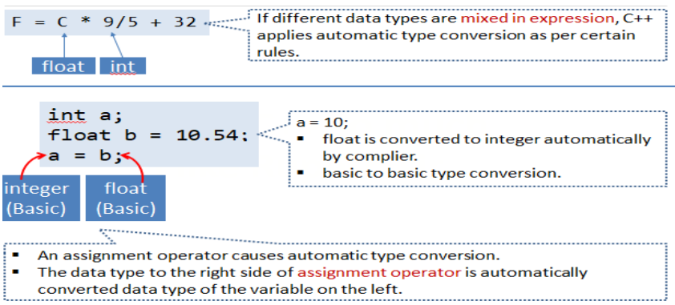
Type Conversion
The type conversions are automatic only when the data types involved are built-in types

Slide 38
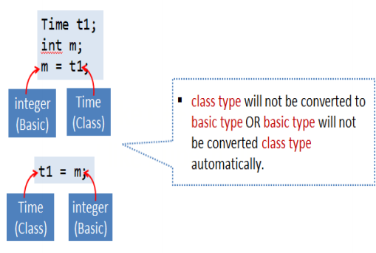
Type Conversion for User-Defined Data Types
For user defined data types, the compiler does not support automatic type conversions
The data conversion interface function should be explicitly specified by the user
A single argument constructor or operator function could be used for conversion of objects of different classes

Slide 39
Type Conversions
Different situations of data conversion between incompatible types
  Conversion from basic type to class type
  Conversion from class type to basic type
  Conversion from one class type to another class type
Conversion type | Source class | Destination class
Basic→ class | Not applicable | Constructor
Class→ basic | Casting Operator | Not Applicable
Class→ class | Casting operator | Constructor

Slide 40
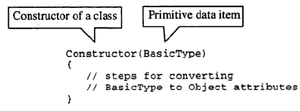
Conversion from Basic type to Class type (user-defined)
To convert basic to user-defined data type, single argument conversion constructor routine should be written in the destination object class
The compiler uses this constructor to perform implicit class-type conversions
Conversion Constructor – takes a single argument of basic data type

Slide 41
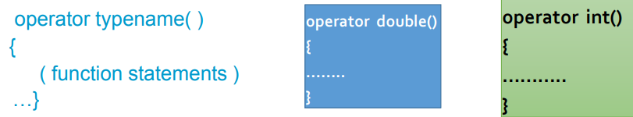
Conversion from Class type (user-defined) to Basic Type
A constructor function do not support type conversion from a class type to a basic type
An overloaded casting operator is used to convert a class type data to a basic type. It should be written in the source object class
It is also referred to as conversion function
This function converts a class type data to typename
  Converts the class object of which it is a member to typename.
  The typename may be a built-in type or a user-defined one.

Slide 42
Casting Operator Function
The casting operator function should satisfy the following conditions
  It must be a class member
  It must not specify a return type
  It must not have any arguments
Conversion functions are member functions and it is invoked with objects
Therefore the values used for conversion inside the function belong to the object that invoked the function
This means that the function does not need an argument
This overloaded typecast operator function does not have any return type(not even void)
Because the returntype is the typename to which the object is being converted

Slide 43
Type Conversion - Example
Class Meter {
private :
float length;
public:
Meter()
{ length = 0.0; }
// Conversion from basic to user-defined
Meter (float intlength) // conversion constructor
{ length = intlength /100.0; }
// Conversion from user-defined to basic
operator float() // overloaded casting operator
{ float lengthcms;
lengthcms = length * 100.0;
return (lengthcms); }
void Getlength()
{ cin>>length; }
void Showlength()
{ cout << “length in Meter”<<length; }
};
main() {
Meter M1;
float length1;
cin>>length1;
M1=length1; //basic to class type
M1.Showlength();
Meter M2;
float length2;
M2.Getlength();
length2=M2; //class type to basic
cout<<length2;
}

Slide 44
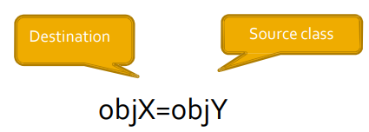
Conversion from One Class Type to another Class Type
objX = objY ; // objects of different types
objX is an object of class X and objY is an object of class Y
The class Y type data is converted to the class X type data and the converted value is assigned to the objX
Conversion is takes place from class Y to class X
Y is known as source class
X is known as destination class
Conversion between objects of different classes can be carried out by either
1) Constructor
2) Casting operator function
Using Casting operator function source class
Using constructor function in destination class

Slide 45
Example – Conversion Routine in the Source Class
class Degree
{ float degree;
public:
Degree()
{ degree = 0.0; }
operator Radian()
{ return (Radian (degree * pi / 180.0));
void input()
{ cin >> degree; }
};
main()
{
Degree D1;
Radian R1;
D1. input();
R1=D1; //uses operator Radian()
R1.output();
}
#include<iostream>
using namespace std;
const float pi=3.14;
class Radian
{ float rad;
public:
Radian()
{ rad = 0.0; }
Radian (float intrad)
{ rad = intrad; }
float Getradian()
{ return rad;}
void output()
{ cout << Getradian(); }
};

Slide 46
Example – Conversion Routine in the Destination Class
class Degree
{ float degree;
public:
Degree()
{ degree = 0.0; }
void input()
{ cin >> degree; }
float Getdegree()
{ return degree; }
};
main()
{
Degree D1;
Radian R1;
D1. input();
R1=D1; //uses Radian(Degree Deg)
R1.output();
}
#include<iostream>
using namespace std;
const float pi=3.14;
class Radian
{ float rad;
public:
Radian()
{ rad = 0.0; }
Radian (Degree deg)
{ rad = deg. Getdegree() * pi /180.0; }
void output()
{ cout << Getradian(); }
};

